Slide 1
Segment Registers: Additional registers, called segment registers, generate memory addresses when combined with other registers in the microprocessor. A segment register functions differently in the real mode when compared to the protected mode operation of the microprocessor.
CS (code): The code segment is a section of memory that holds the code (programs and procedures) used by the microprocessor. The code segment register defines the starting address of the section of memory holding code. In real mode operation, it defines the start of a 64K byte section of memory; in protected mode, it selects a descriptor that describes the starting address and length of a section of memory holding code. The code segment length is limited to 64K bytes in the 8088-80286 and 4G bytes in the 80386 and above when these microprocessors operate in the protected mode.

Slide 2
DS (data): The data segment is a section of memory that contains most data used by a program. Data are accessed in the data segment by an offset address or the contents of other registers that hold the offset address. As with the code segment and other segments, the length is limited to 64K bytes in the 8086-80286 and 4G bytes in the 80386 and above.
ES (extra): The extra segment is an additional data segment used by some of the string instructions to hold destination data.
SS (stack): The stack segment defines the area of memory used for the stack. The location of the current entry point in the stack segment is determined by the slack pointer register. The BP register also addresses data within the stack segment.
FS and GS: The FS and GS segments are supplemental segment registers available in the 8086, 80486, Pentium and higher processors to allow two additional memory segments ofr access by porgrams.

Slide 3
Real Mode Memory Addressing: The 80286 and above operate in either the real or protected mode. Only the 8086 and 8088 operate exclusively in the real mode. Real mode operation allows the microprocessor to address only (he first 1M byte of memory space—even the Pentium microprocessor. Note that the first 1M byte of memory is called either the real memory or conventional memory system.
Segments and Offsets
A combination of a segment address and an offset address access a memory location in the real mode. All real mode memory addresses consist of a segment address plus an offset address. The segment address, located within one of the segment registers, defines the beginning address of any 64K-byte memory segment. The offset address selects any location within the 64K-byte memory segment.

Slide 4
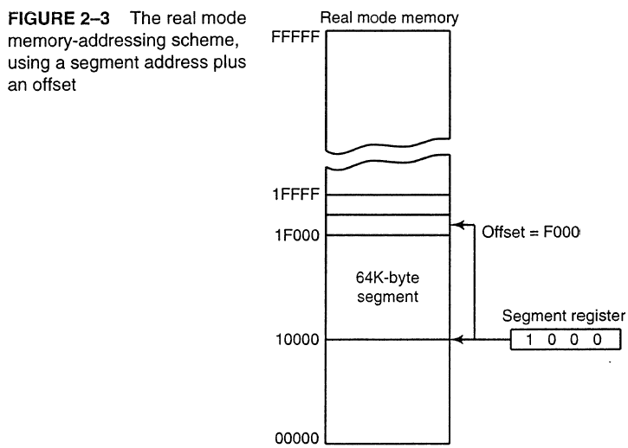

Slide 5
The segment register in Figure 2-3 contains a 1000H, yet it addresses a starting segment at location 10000H. In the real mode, each segment register is internally appended with a 0H on its rightmost end. This forms a 20-bit memory address, allowing it to access the start of a segment at any 16-byte boundary within the first 1M byte of memory. This is required in the microprocessor to generate a 20-bit memory address.
For example, if a segment register contains a 1200H, it addresses a 64K-byte memory segment beginning at location 12000H. Likewise, if a segment register contains a 1201H, it addresses a memory segment beginning at location 12010H. Because of the internally appended 0H, real mode segments can only begin at a 16-byte boundary in the memory system. This 16-byte boundary is often called a paragraph

Slide 6
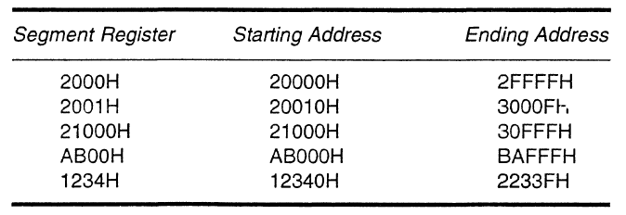
Because a real mode segment of memory is 64K in length, once the beginning address is known, the ending address is found by adding FFFFH. For example, if a segment register con­tains 3000H, the first address of the segment is 30000H and the last address is 30000H + FFFFH or 3FFFFH. Table 2-1 shows several examples of segment register contents and the starting and ending addresses of the memory segments selected by each segment address.

Slide 7
The offset address is added to the start of the segment to address a memory location in the memory segment. For example, if the segment address is 1000H and the offset address is 2000H, the microprocessor addresses memory location 12000H. The segment and offset address is sometimes written as 1000:2000 for a segment address of 1000H with an offset of 2000H.
Some addressing modes combine more than one register and an offset value to form an offset address. When this occurs, the sum of these values may exceed FFFFH. For example, the address accessed in a segment whose segment address is 3000H and whose offset address is specified as the sum of F000H plus 3000H will access memory location 32000H, instead of location 42000H. When the F000H and 3000H are added, they form a 16-bit (modulo 16) sum of 2000H used as the offset address and not 12000H, the true sum. Note that the carry of 1 (F000H + 3000H = 12000H) is dropped for this addition to form the offset address of 2000H.

Slide 8
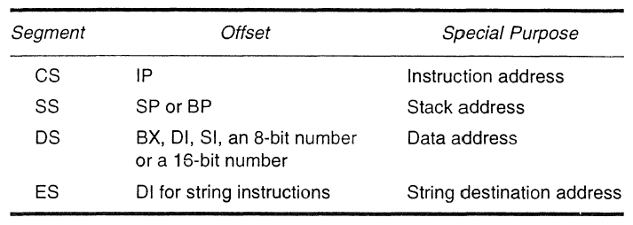
Default Segment and Offset Registers:
The microprocessor has a set of rules that apply to segments whenever memory is addressed. These rules, which apply in either the real or protected mode, define the segment register and offset register combination used by certain addressing modes.
Table 2-2 8086- 80486 and higher microprocessor 16-bit segment and offset address combinations.

Slide 9
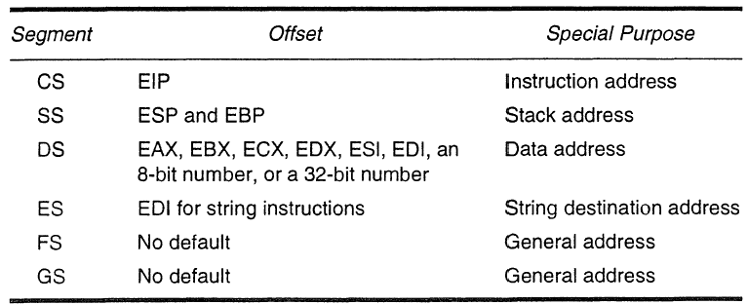
Table 2-3: 80386, 80486 and higher microprocessor 32-bit segment and offset address combinations.

Slide 10
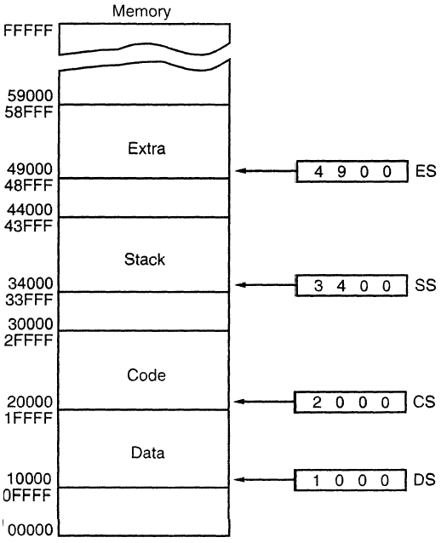
Figure 2-4: A memory system showing the placement of four memory segments

Slide 11
Protected Mode Memory Addressing: Protected mode memory addressing (80286 and above) allows access to data and programs located above the first 1M byte of memory as well as within the first 1M byte of memory. Now the offset address is still used to access information located within the memory segment. The difference is that the segment address, as discussed with real mode memory addressing, is no longer present in the protected mode.
In place of the segment address, the segment register contains a selector that selects a descriptor from a descriptor table. The descriptor describes the memory segment's location, length, and access rights.
Selectors and Descriptors
The selector, located in the segment register, selects one of 8,192 descriptors from one of two tables of descriptors. The descriptor describes the location, length, and access rights of the segment. Indirectly, the segment register still selects a memory segment, but not directly as in the real mode.

Slide 12
There are two descriptor tables used with the segment registers: one contains global descriptors and the other contains local descriptors. The global descriptors contain segment definitions that apply to all programs, while the local descriptors are usually unique to an application. Each descriptor table contains 8,192 descriptors, so a total of 16,384 descriptors are available to an application at any time. Because the descriptor describes a memory segment, this allows up to 16,384 memory segments to be described for each application.
Figure 2-6 shows the format of a descriptor for the 80286 through the Pentium Pro. Note that each descriptor is 8 bytes in length, so the global and local descriptor tables are each a maximum of 64K bytes in length.

Slide 13
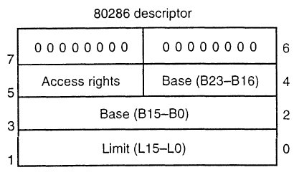
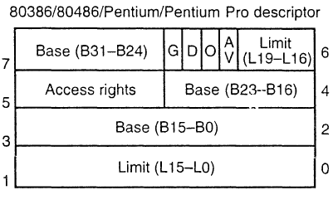

Slide 14
The base address portion of the descriptor indicates the starting location of the memory segment.
For the 80286 microprocessor, the base address is a 24-bit address, so segments begin at any location in its 16M bytes of memory.
Note that the paragraph boundary limitation is removed in these microprocessors when operated in the protected mode.
The 80386 and above use a 32-bit base address that allows segments to begin at any location in its 4G bytes of memory.

Slide 15
The segment limit contains the last offset address found in a segment. For example, assume that a segment begins at memory location F00000H and ends at location F000FFH. For the 80286 microprocessor, the base address is F00000H and the limit is 00FFH. For the 80386 and above, the base address is 00F00000H and the limit is 000FFH.
Notice that the 80286 has a 16-bit limit, and the 80386 through the Pentium Pro have a 20-bit limit. The 80286 accesses memory segments that are between 1 and 64K bytes in length. The 80386 and above access memory segments that are between 1 and IM byte or 4K and 4G bytes in length.

Slide 16
The G bit is called granularity bit. If G = 0, the limit specifies a segment limit of from 1 to 1M byte in length. If G = 1, the value of the limit is multiplied by 4K bytes (appended with 000H). If G = 1, the limit is any multiple of 4K bytes. This allows a segment length of 4K to 4G bytes in steps of 4K bytes.
The AV bit, in the 80386 and above descriptor, is used by some operating systems to indicate that the segment is available (AV = 1) or not available (AV = 0).
The D bit indicates how the 80386 through the Pentium Pro instructions access register and memory data in the protected or real mode. If D = 0, the instructions are 16-bit instructions compatible with the 8086-80286 microprocessors. This means that the instructions use 16-bit offset addresses and 16-bit registers by default.

